Slide 1

Chicago crime analysis
Maisa Basher
CS 2316
Professor: Dr. Melinda McDaniel

Slide 2
Motivation
Interested in working with different kinds of crimes and crime rates in the US
Most Resources provide State base data
Chicago is one of the states that has the highest crime rate

Slide 3
Expectation
The overall idea of the crime situation in Chicago compared to the entire US crime report.
Data about the type of crimes that are frequent there.
Safe or Dangerous area in Chicago based on crime frequency.

Slide 4
Data Collection
Found different resources with the report of Chicago crime
Focused more on government websites for data with inconsistencies
Finalized the data that had reported crime cases in Chicago during 2022 and from 2010 -2021.
Webpage with US crime rate and safe neighborhood in Chicago.

Slide 5
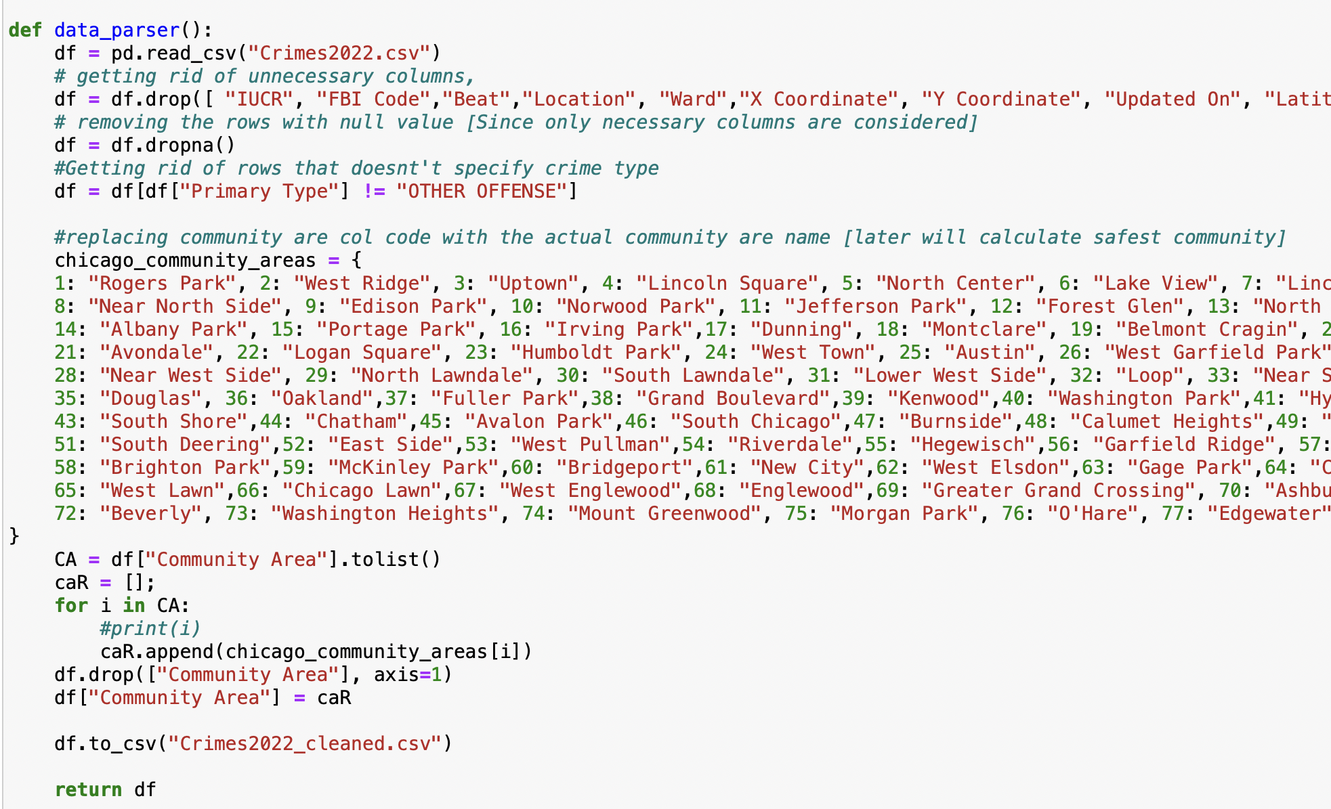
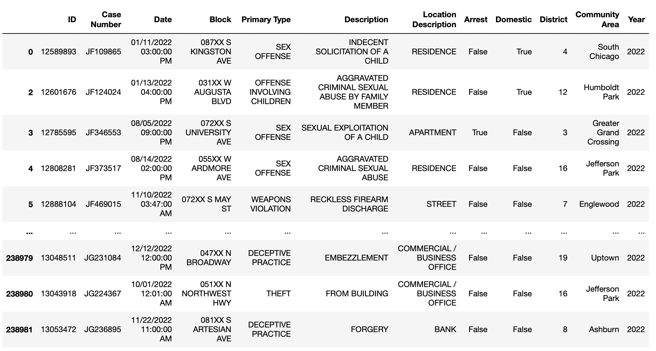
Data Cleaning #downloaded data(CSV)
Removed the rows with Null values for necessary columns
Removes the cases that don’t specify crime type

Slide 6
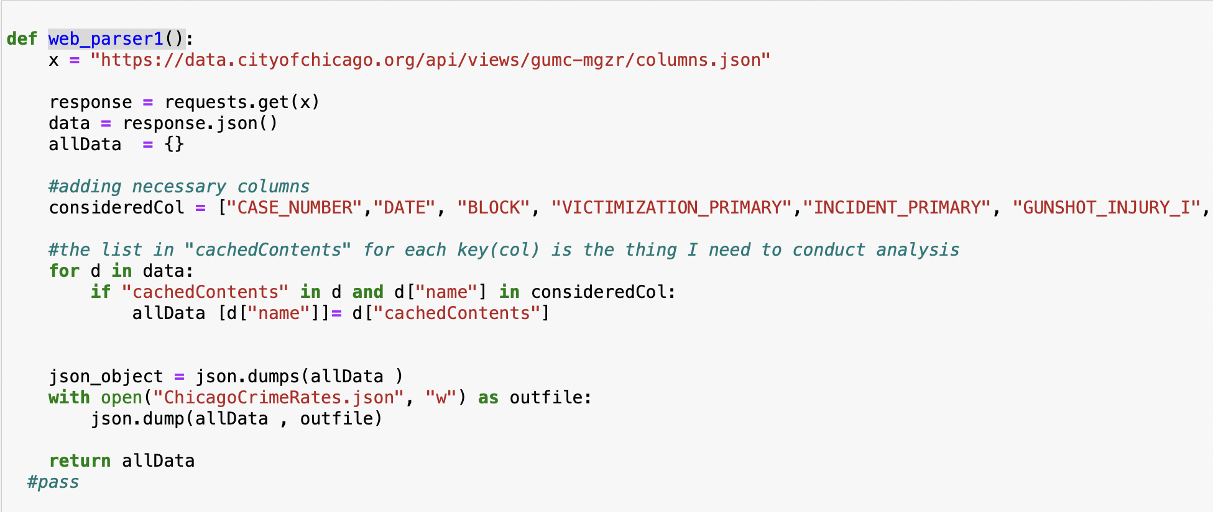
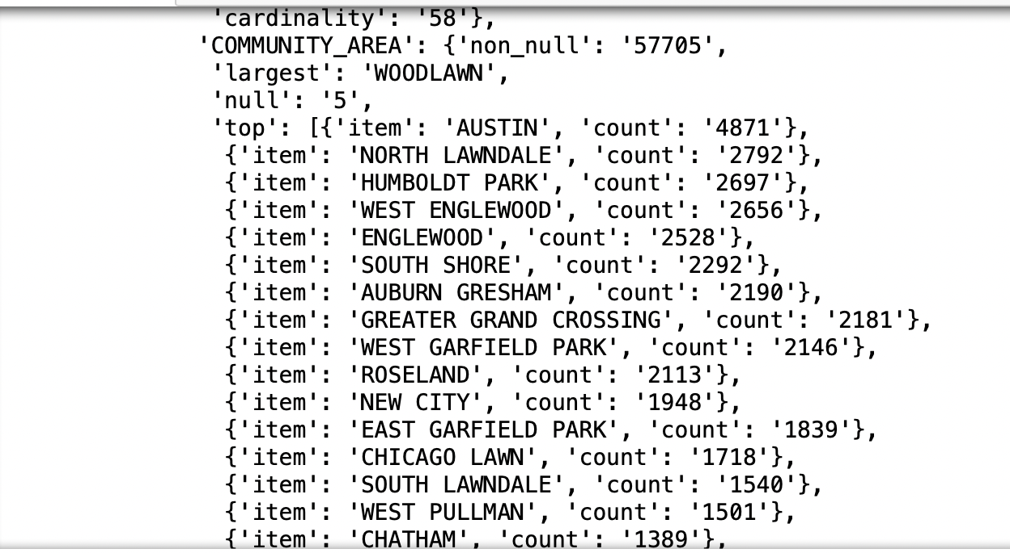
Data Cleaning #Web Requirement1(JSON)
Considered Keys that are necessary for analysis.
Considered the Keys with “CatchedContent”

Slide 7
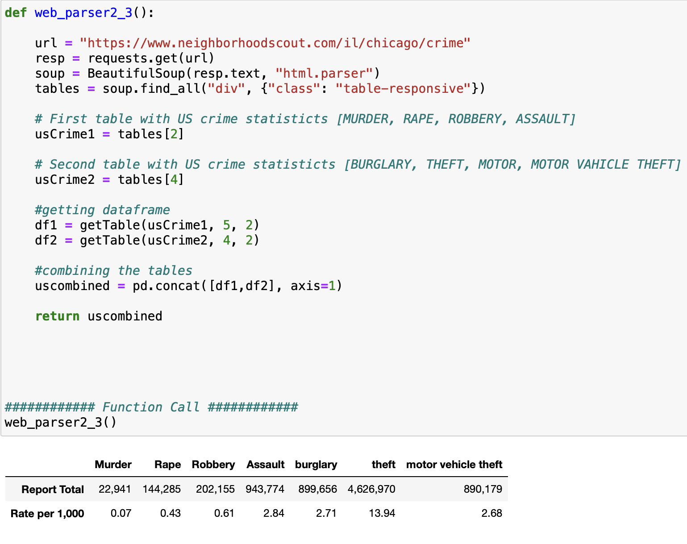
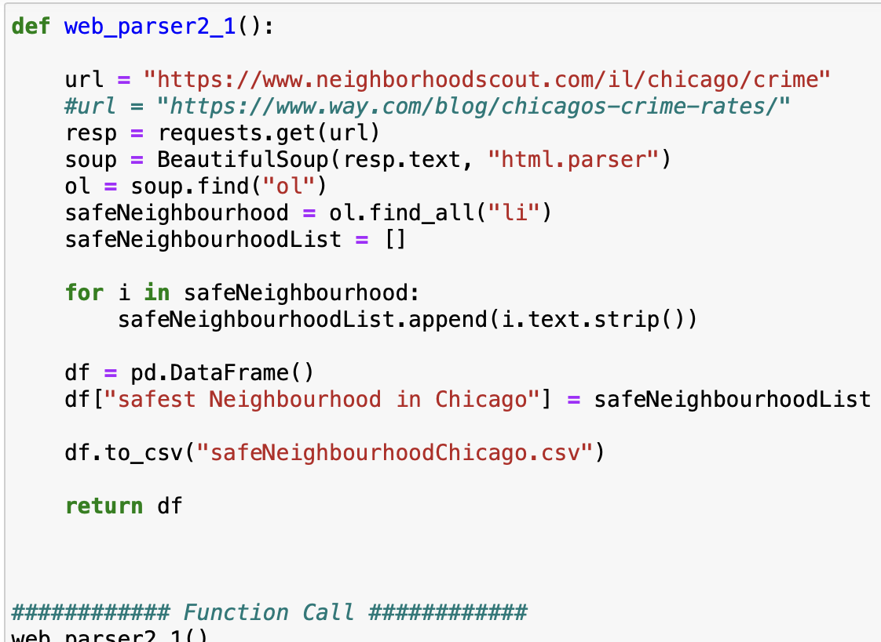
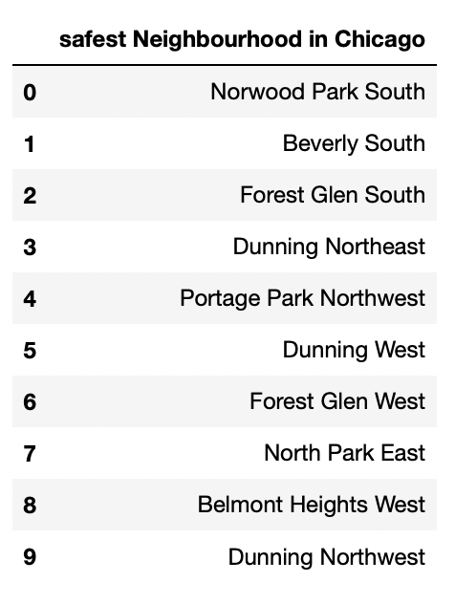
Data Cleaning #Web Requirement1(WebPage)
Us Crime report
Safest Neighborhood reported by residents

Slide 8
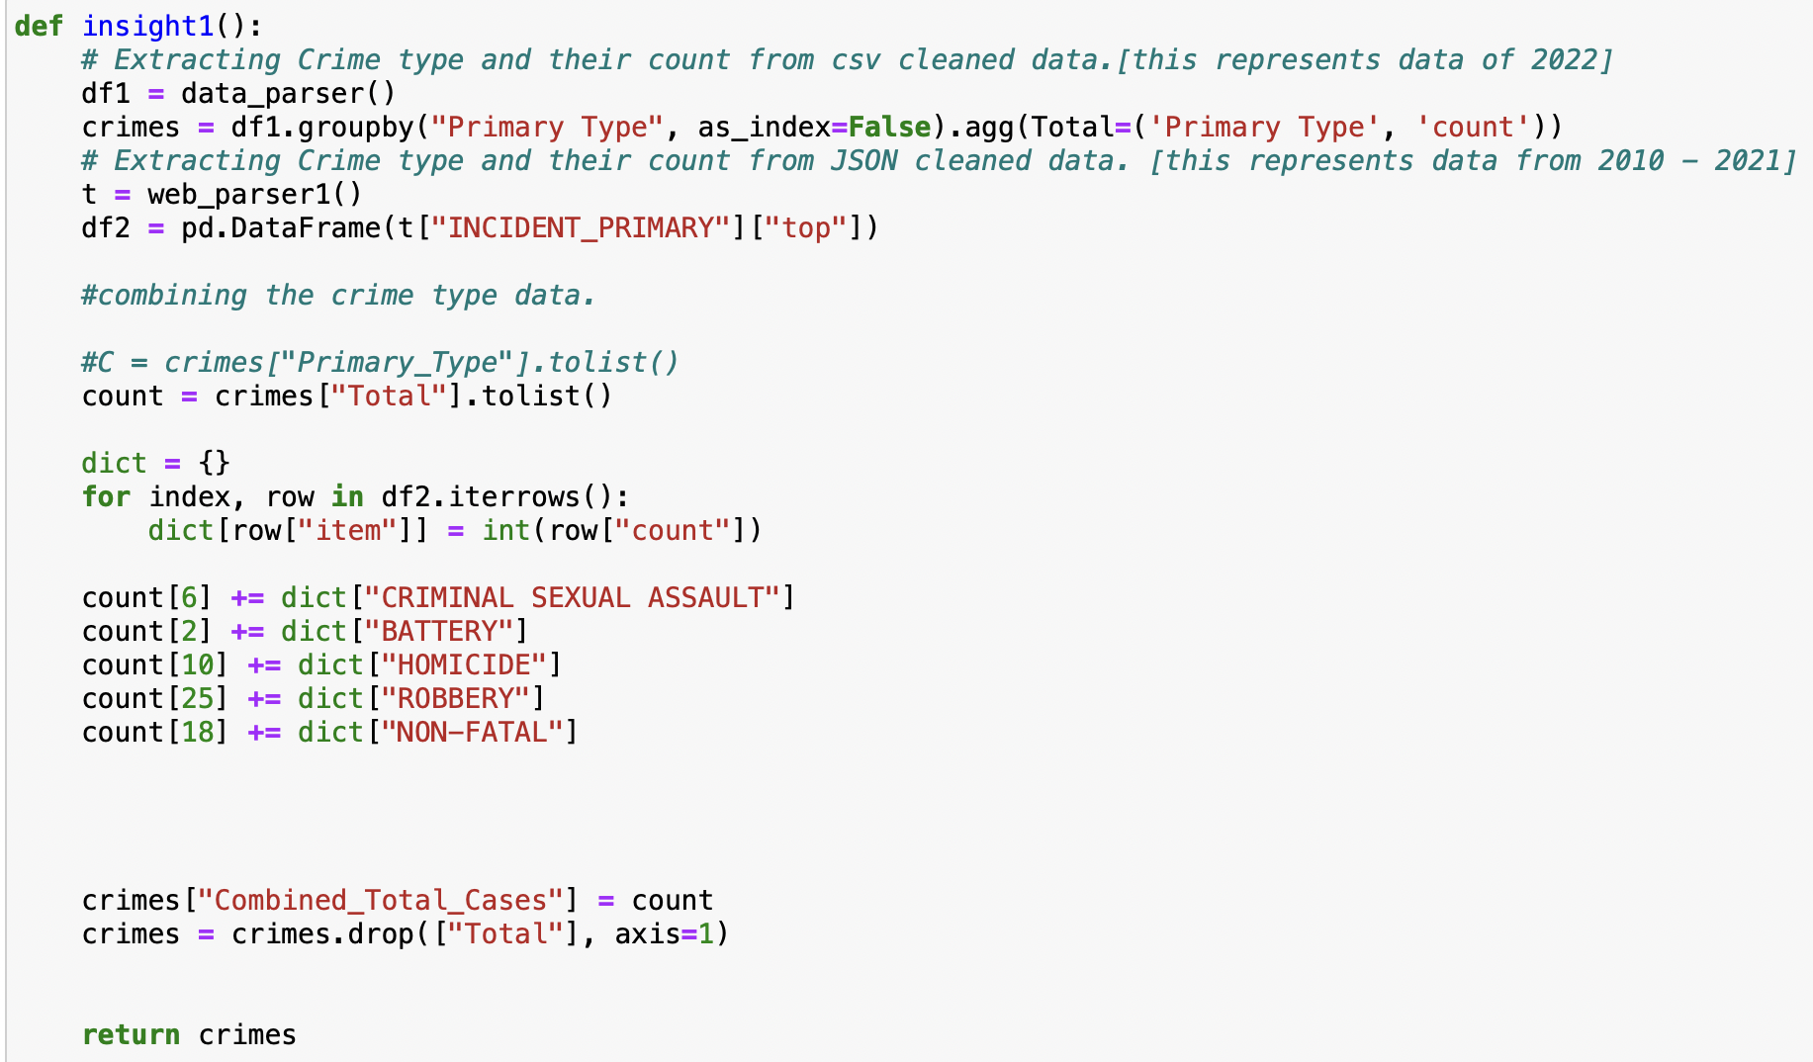
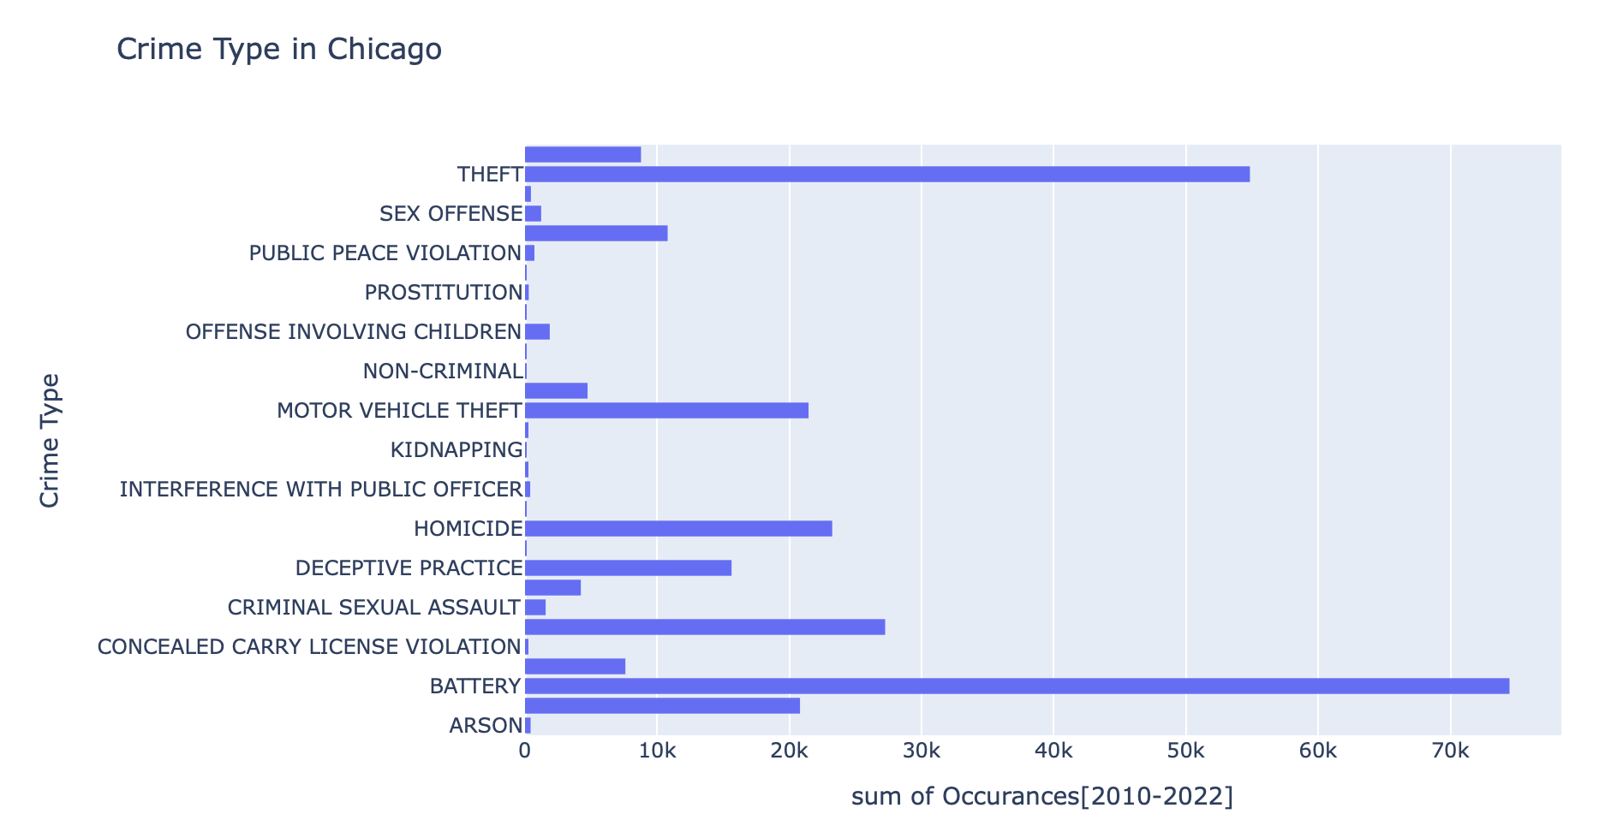
Insight_1 Crime Type & Frequency

Slide 9
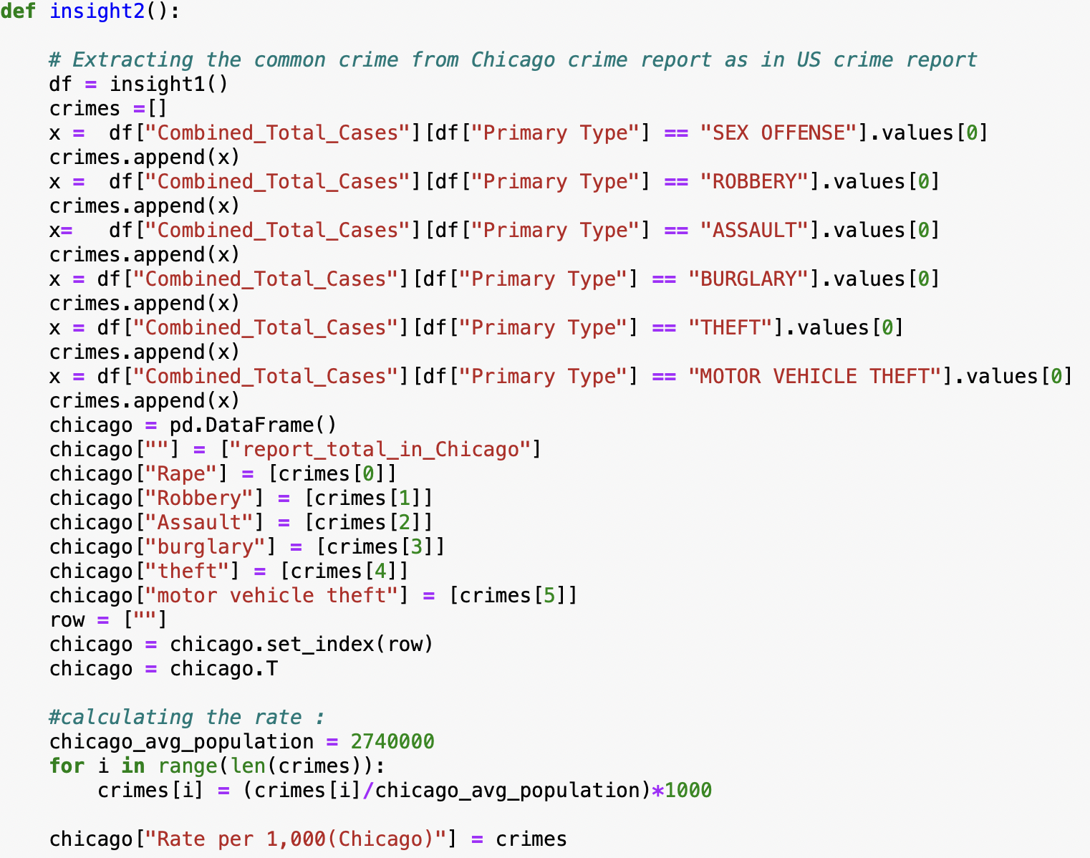
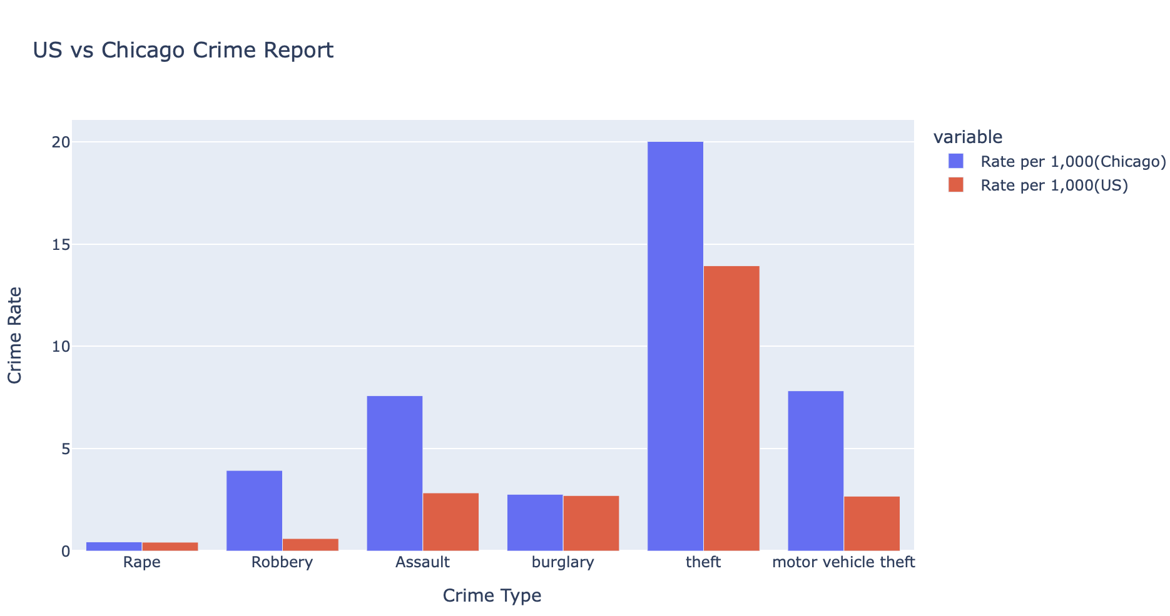
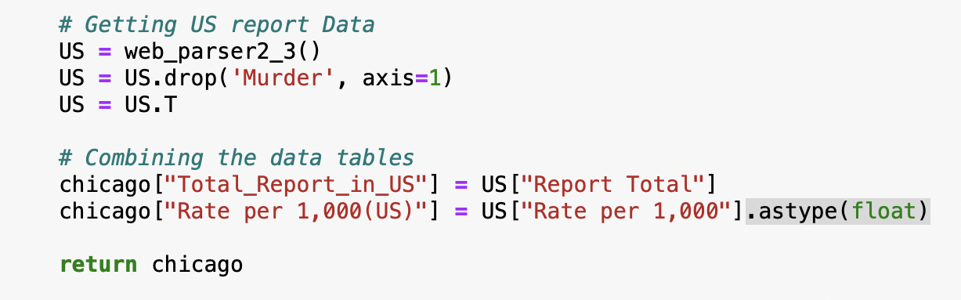
Insight_2 US vs Chicago Crime Report

Slide 10
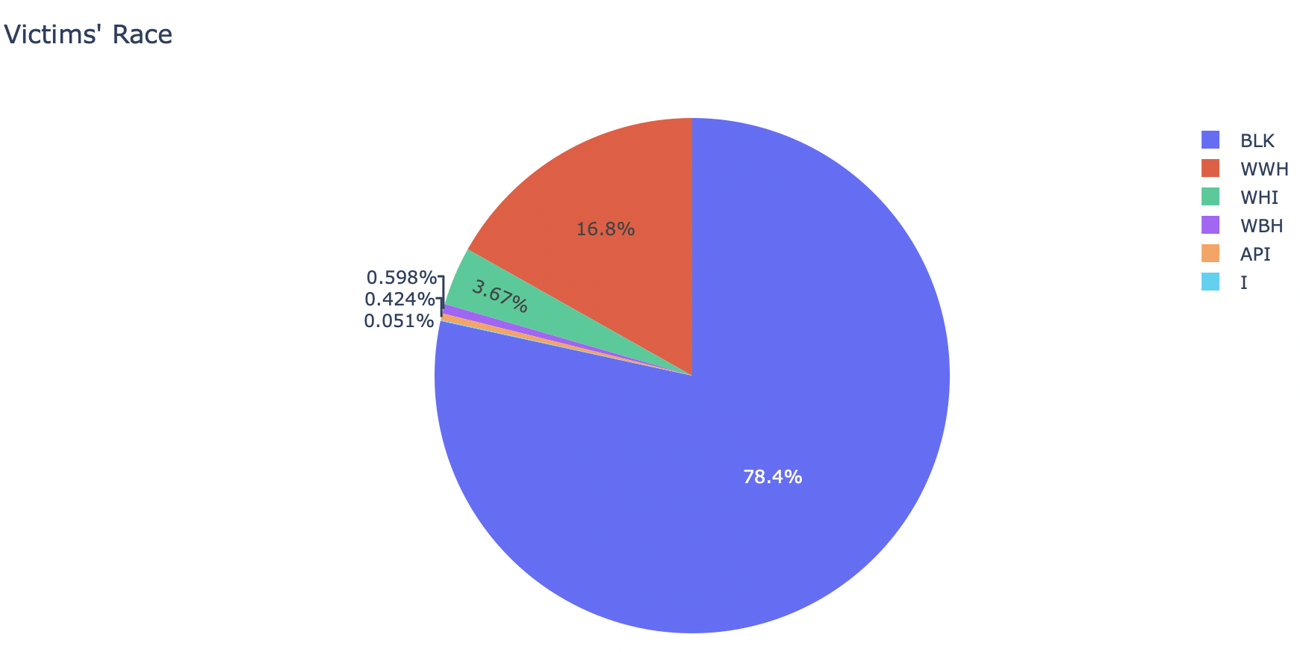
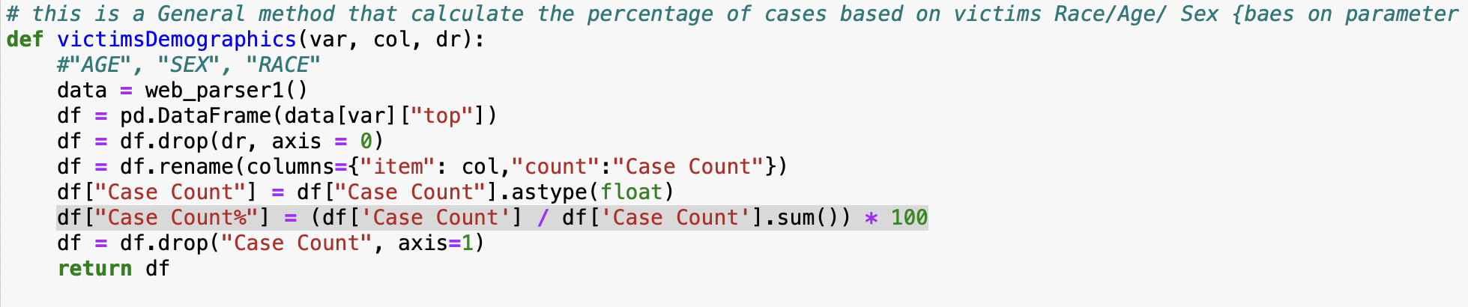
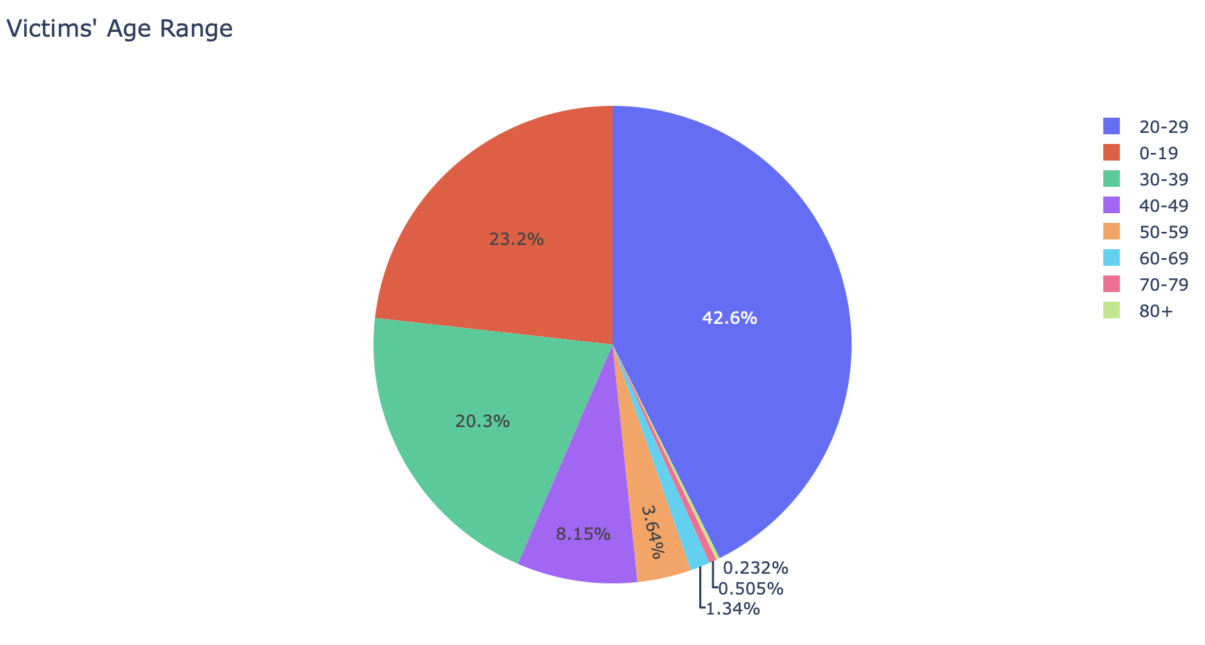
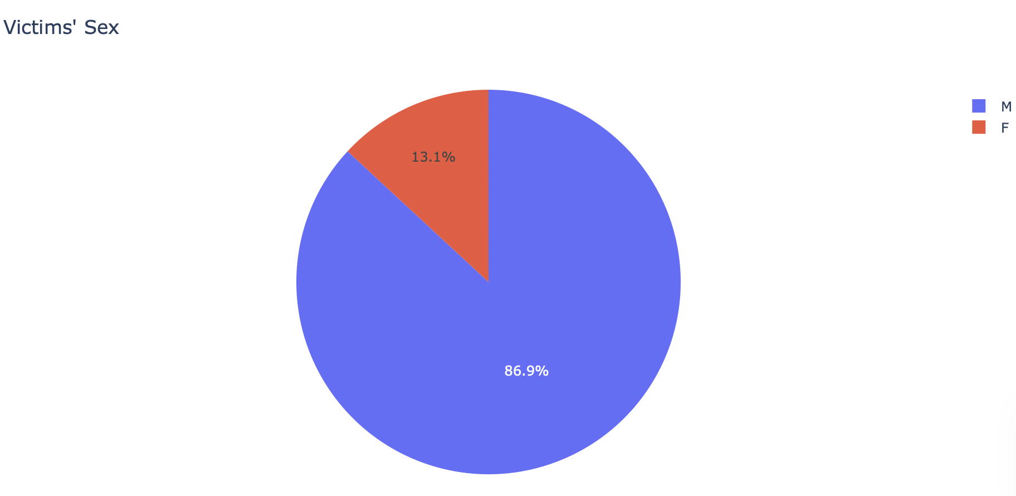
Insight_3 Victims demographics

Slide 11
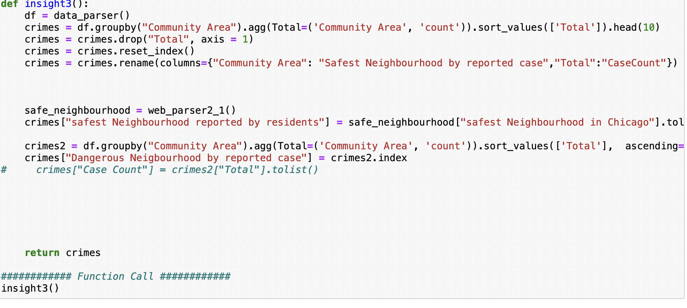
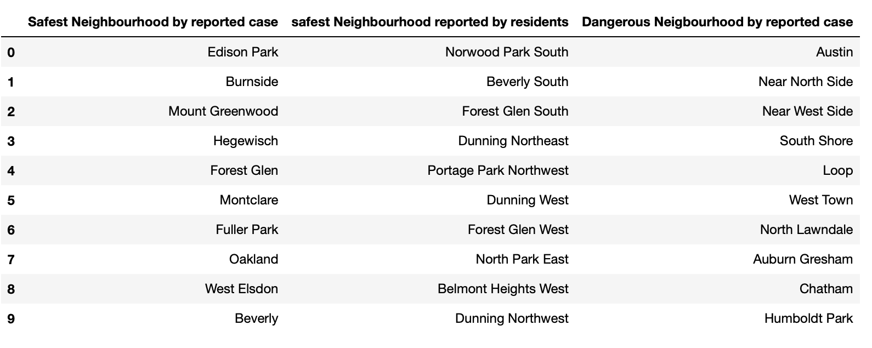
Insight_4 Safe and Dangerous neighborhood.

Slide 12
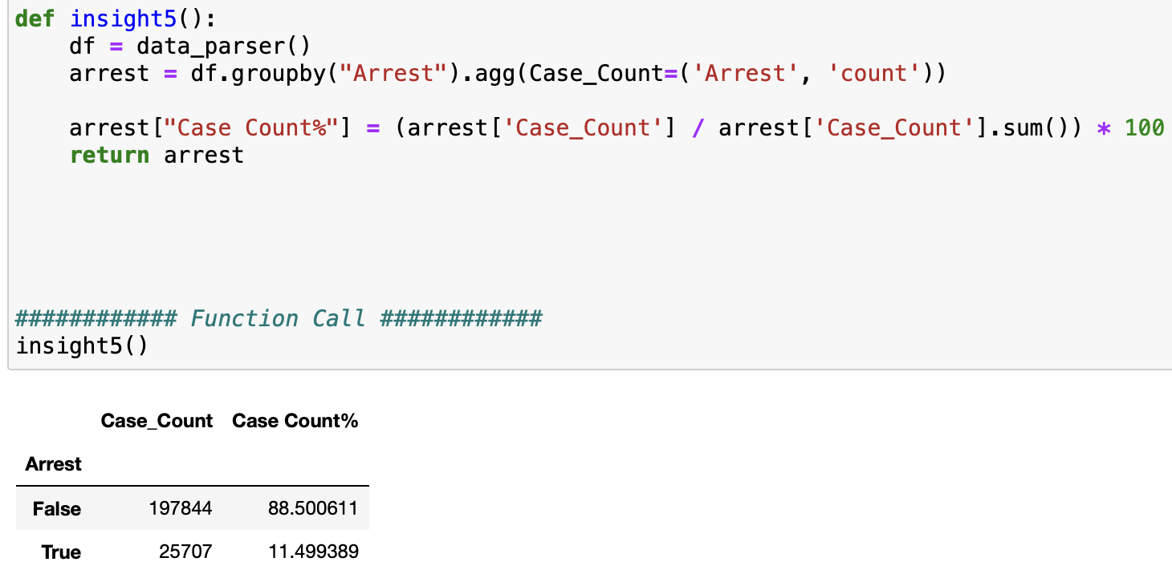
Insight_5 resolved cases

Slide 13
Learning
Technology concept: Numpy, Pandas, data visualization (plotly)
Practice data analysis
Working with large data

Slide 14
Thank you

